Slide 1


FLIX FARM
Discover the movies of your kind

Slide 2

What is Flix Farm?
Flix Farm is a Movie Forum and database where Movie buffs can post reviews, create/share watchlists and see all the popular and trending movies from around the world

Slide 3

CONTENTS
Project Statement
Functionalities
Use Cases
Technologies
Future Scope
References

Slide 4

PROJECT STATEMENT
Flix Farm is a Movie Forum where end users can login as a critic or a regular user to post reviews, create watchlists, checkout the cast, movie synopsis, get access to the trending tweets and lots more.

Slide 5
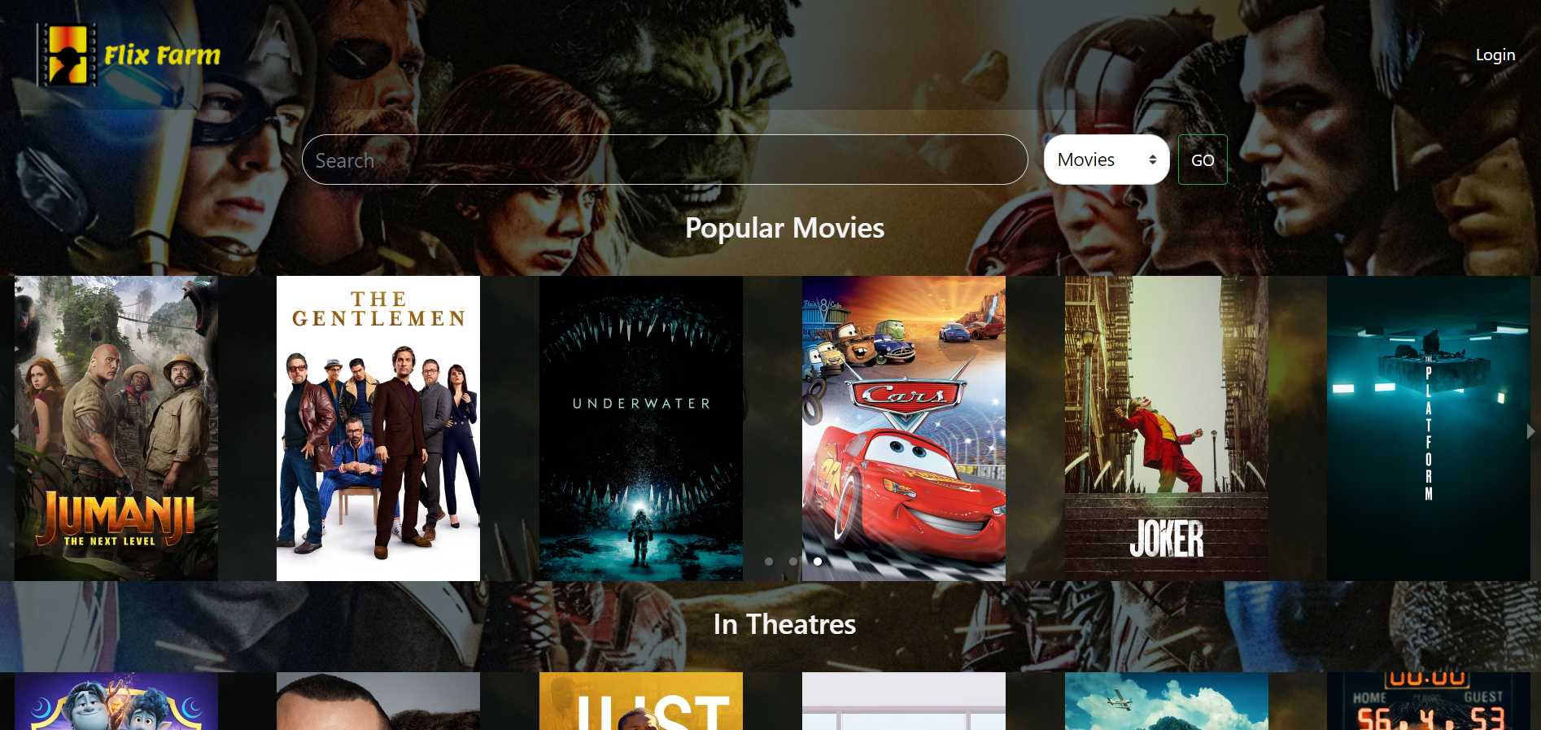
FUNCTIONALITIES
User and Critic Login/Registration
Search Movies
Create WatchLists
Follow Critics & Users
Get Access to Twitter Feed
View/Post Movie Reviews
Movie Description and Cast

Slide 6
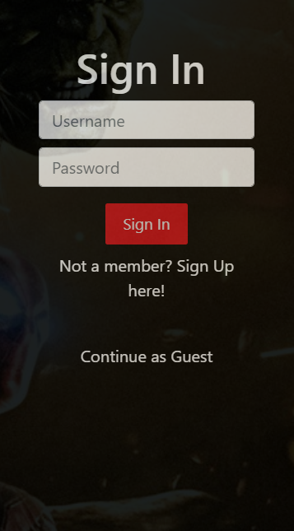
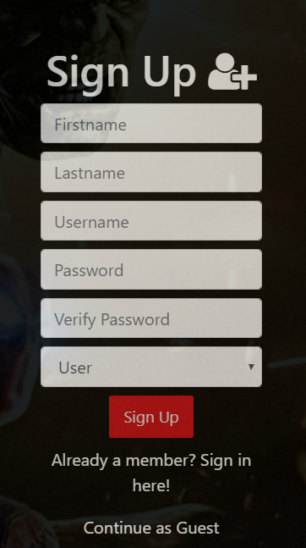
USER AND CRITIC LOGIN/REGISTRATION
User can Login as an End User or as a critic.
Credentials are registered in the database.

Slide 7
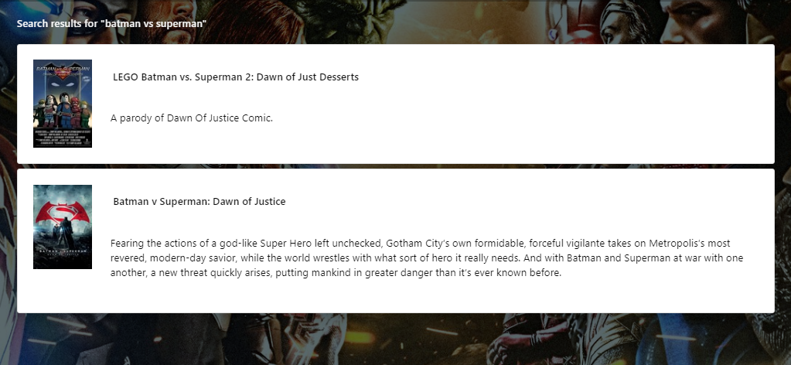
SEARCH MOVIES
Search Bar option provides user the option to search for their favourite movies and Users

Slide 8
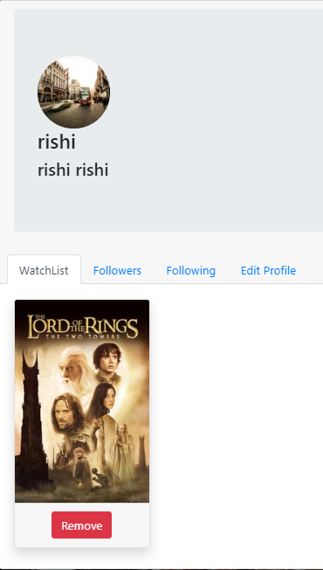

CREATE WATCHLISTS
The button “Add to Watchlist” enables the user to add movies to a list and users can access their followers’ watchlists

Slide 9
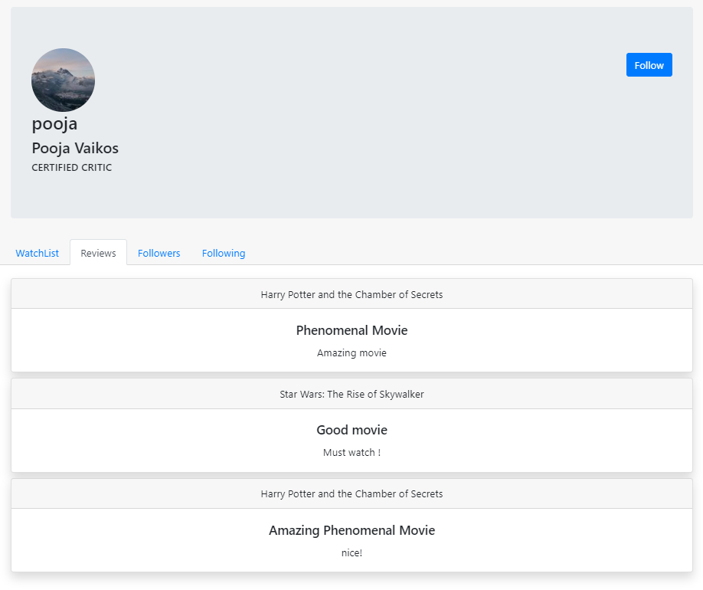
FOLLOW CRITICS & USERS
This functionality brings in a sharing platform for movies.
Users can follow users and critics to follow watchlists and popular reviews

Slide 10

GET ACCESS TO TWITTER FEED
The users get access to some of the top trending tweets about the movie.

Slide 11
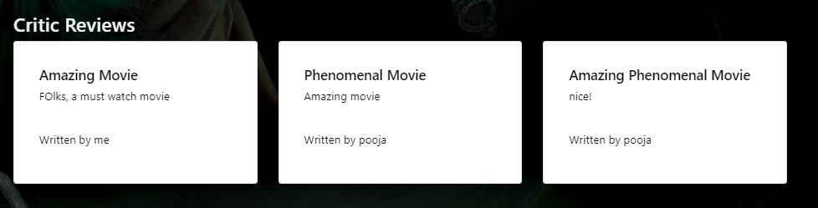
VIEW / POST MOVIE REVIEWS
Users and Critics can post and view Reviews on movies

Slide 12
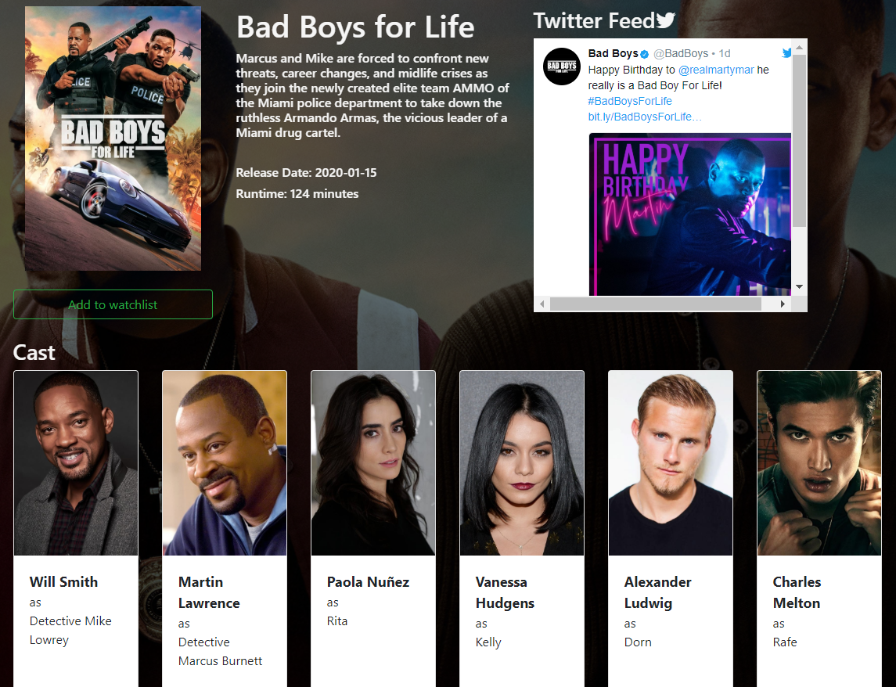
MOVIE DESCRIPTION AND CAST
Users get access to Movie synopsis and Cast

Slide 13



TECHNOLOGIES
TMDB API is used for fetching all movie details.
Tech Stack used:
MongoDB
React
Express
Node.js
MERN stack was chosen as our tech stack taking into consideration scalability and superior performance.

Slide 14
USED LIBRARIES
Bootstrap
Font-awesome
React-dom
React-pose
React-tweet
Responsive-carousel

Slide 15
FUTURE SCOPE
Can be expanded to a movie streaming site
Integration of Pay and Watch system
Movie Rating System where it can be a popular standard for ratings and reviews
Movie Recommendations based on watchlist. Using AI, we can categorize the genres and generate a recommended movies list

Slide 16
REFERENCES
Themoviedb. (n.d.). Retrieved April 18, 2020, from https://www.themoviedb.org/
Standard search API - Twitter Developers. (n.d.). Retrieved April 18, 2020, from https://developer.twitter.com/en/docs/tweets/search/api-reference/get-search-tweet

Slide 17

TEAM MEMBERS
Abhilash Wase
Ajith Babu Ramesh
Keshav KL
Vaishnavi Mande

Slide 18
THANK YOU!

